Slide 1

Hotel Cancellation
Prediction
Sivaramakrishnan S – Capstone Project – Great Learning July 2020 Batch

Slide 2
Objective
The objective of the project is to predict the hotel booking cancellation status of the guest if it is be cancelled or not based on the features.
Constraints
🤷‍♂️
🌐
Business Problem Understanding
Free Cancellation polices accustomed by Customers
Increase of Hotel Booking via OTA(Online Travel Agencies)
📈
Increase in Cancellation rate to 40% in 2018
💸
Reviews influenced $46 billion of travel spending in 2017 – Trip Adviser
🌤
⚙️
Un-availability of the Forecasting
Issues in Hotel Operations
Impacts
✔ Revenue Loss ✔ Non Optimized occupancy ✔ Poor Management

Slide 3
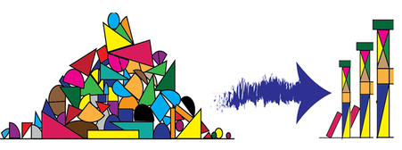


Scope
Understand and Transform the data
EDA (Exploratory data analysis )
Feature engineering (Adding / Modify or Delete)
Pre-Processing
Business Problem Understanding
Feature selection
Build machine learning models
Model evolutions
Insights and Recommendations

Slide 4
High level view on the Data Set
# of records – 1,19,390
# of features – 25
# of features with null values – 3 (Company has 94%)
# of duplicates – 33,210 (21%)
Most of the features provided as categorical(11)/int64(12)
There are 2 date type features provided (Booking / Arrival Date)
Understanding Data

Slide 5
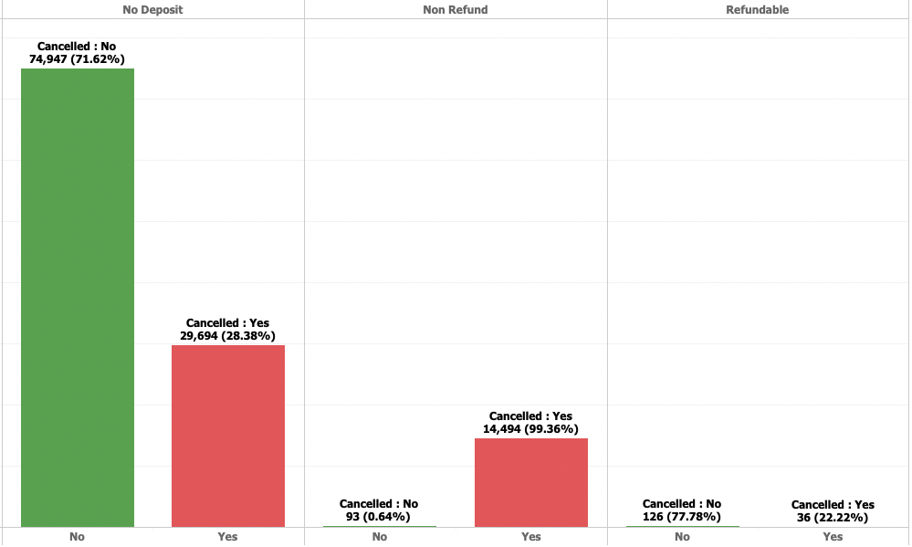
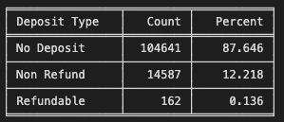
Deposit Type
Understanding Data
The Non Refundable Deposit has the highest cancellation

Slide 6
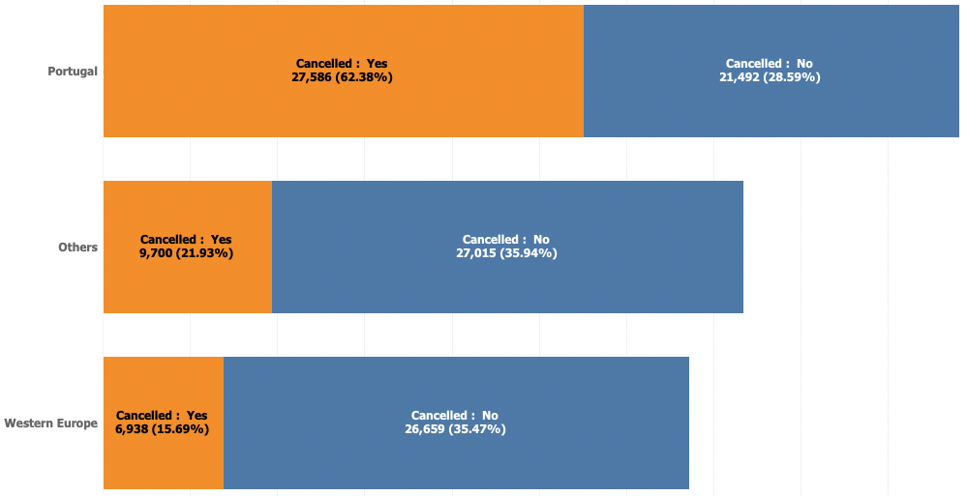
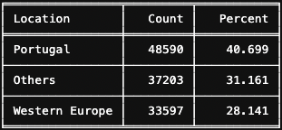
Location
Understanding Data
The booking made in Portugal are almost 2.5 X more likely to be cancelled compared to booking that's made outside Portugal

Slide 7
High level Approach
Correlation Check on Target
Split the data as 85%(Train) and 15%(Test)
Base Models & Tuned
Logistic Regression
LDA (LinearDiscriminantAnalysis)
Navie Bayes
Random Forest
KNN – K Nearest Neighbour
Artificial Neural Networks (ANN)
XG-Boost
Ensemble Models
Bagging
Ada-Boosting
Gradient Boosting
Modelling Approach Used & Why
Performance Metrics
Scores (Precision, Recall, F-Accuracy and AUC)
Confusion Matrix
ROC Curve

Slide 8
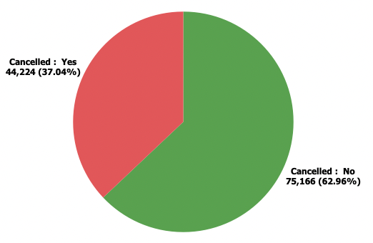
Classification Model
Our goal here is to correctly classify the cancellation status(is_canceled) of the hotel booking.
The classification class are Cancelled as (1) and Not Cancelled as (0).
Modelling Approach Used & Why
High Correlation on Target VS Predictors

Slide 9
Model Metrics
Model Metrics Comparisons

Slide 10
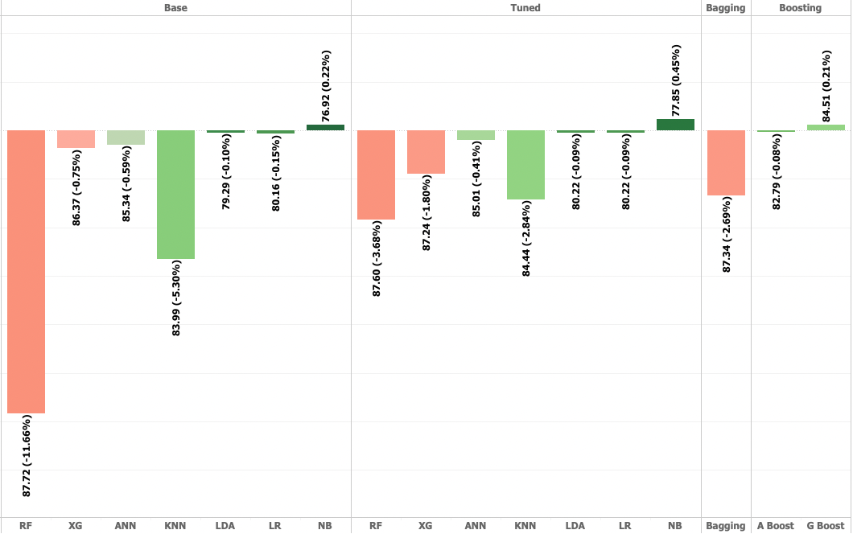
Accuracy Variance compression by Models on Base and Tuned
Model Metrics Comparisons

Slide 11
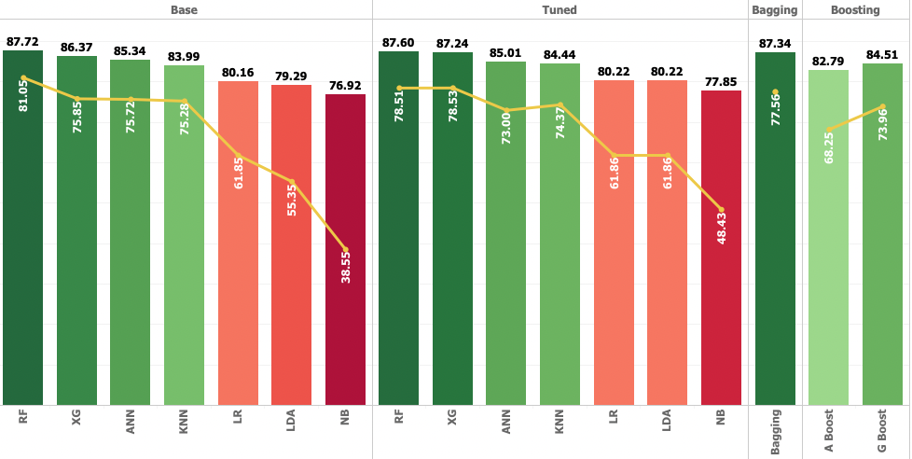
The Trend of Accuracy and Recall for Models broken down by Base, Tuned & Ensemble.
Model Metrics Comparisons

Slide 12
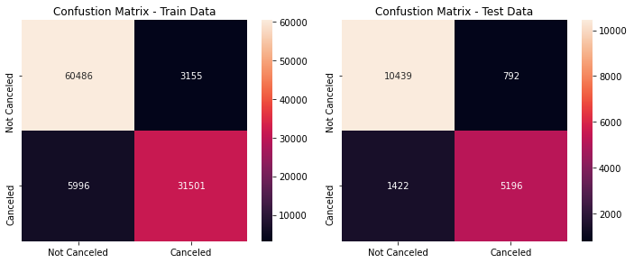
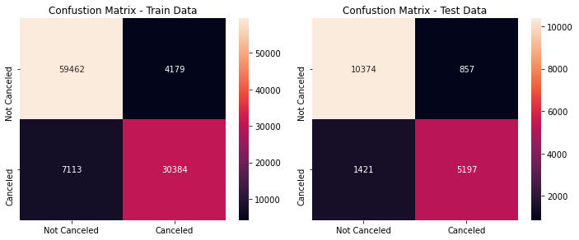
Random Forest
Model Metrics Comparisons
XGBoost

Slide 13
Insights from Analysis
Deposit Type No Refund Booking has the highest cancellation rate at 99.4% No Deposit has cancellation rate of 28.3 % While Refundable has cancellation rate around 22%
Lead Time There are 2 loyal customers with high lead time not cancelled the bookings Booking which is > 7 Months has higher cancelation rate of > 50%
Location Nearly 40% of the data has the Portugal data and which has a 62.38% of cancellation rate. Western Europe has 21.93% cancellation Rate. Others Booking have 15.69% cancellation Rate
Previous cancellation Current cancellation rate of 92% which the customers who already cancelled. The newly cancelled customers rate is 34% 66% of people who not cancelled in the hotel history

Slide 14
Insights from Analysis
Important Features Lead Time, Deposit Type, Special Request, Location (Portugal) and Previous Cancellations.
Base Models Random Forest Overfitting as high Bias: 12.40% and high Variance : 11.58% LR and LDA has High Bias(app 20%) and Low Variance(0.10% - 0.15%) The XGBoost and ANN are the good fit models with Medium Bias (15%) and Low Variance(0.75%) GaussianNB has high precision and unable to predict which is actually predict.
Tuned Models No more overfitting after tuning on the Random Forest. Random Forest, XGBoost and Bagging models almost the accuracy as a 87% upon the XGBoost has a low variance(1.8%). KNN has a good fit even in Tuned, but no major change in the Bias and Variance

Slide 15
Optimum Model Interpretation
Random Forest Model able to predict booking cancellation with 87% of accuracy After tuning the Bias (12.4%) and Variance (3.68%) Still the Recall score as 78.5% so there is a risk of 21.5% of misclassifications. 9%(1422) of the Total test data is classified as True Negative which is Actually Cancelled but classified as Not Cancelled. 5%(792) of the Total test data is classified as False Negative which is Actually Not Cancelled but classified as Cancelled. Based on the all models comparison and accepting all above constraints we are good to choose the Random Forest as the Final Model.

Slide 16
Recommendations
Only Non Refundable Deposit For Group Booking
Solution for the Impact “Revenue Loss”
Only Allowing Non Refundable Rates might result in fewer bookings for Group, however it might protect the hotel from losing revenue.
Setting Maximum Lead Time for Booking
Solution for the Impact “Non Optimised Occupancy”
Setting up maximum lead time means it won’t be able to make booking that's too far in advance (> 210 days)
Increase Direct Booking Market Segment
Solution for the Impact “Poor Management”
From the data set direct booking has the least cancellation rate 15% (outside complimentary) compared to other market segment, with only being 10% of total booking.

Slide 17
Few Strategies to increase Direct Booking
1. Have a mobile-friendly hotel website
Website should be accessible to any device
Offer & Ensure Best Rate Guarantee
Highlight the unique selling services
Optimize website to rank on Google
Nowadays, your guests would always explore your hotel and more options on search engines like Google
Need to perform search engine optimization (SEO) of your hotel website this will help to increase rank in the search engine so your hotel appears in first page of search.
Implement a live chatbot to attend guest inquiries.
Its becomes easy for you to provide instant replies to your website visitors.
When they will get their answer in a fraction of seconds, they will be able to make a decision instantly.

Slide 18
Thank you
Sivaramakrishnan S – Capstone Project – Great Learning July 2020 Batch

